Slide 1


James Seymour
June 2022

Slide 2

Outline
Executive Summary
Introduction
Methodology
Results
Conclusion
Appendix

Slide 3
Executive Summary
SpaceX launch data was collected from multiple sources and used to build classification models with the goal of predicting the success or failure of safely landing the first stage for future reuse.
Initial back testing of the resultant model yields approximately 83% predictive accuracy on available launch data.

Slide 4
Introduction
SpaceX advertises Falcon 9 rocket launches on its website with a cost of 62 million dollars; other providers cost upwards of 165 million dollars each, much of the savings is because SpaceX can reuse the first stage. Therefore, if we can determine if the first stage will land, we can determine the cost of a launch. This project attempts to use available launch data to build a useful machine learning model to predict whether there will be a safe landing of the first stage and thus enable accurate prediction of launch costs.

Slide 5

Section 1

Slide 6
Methodology
Executive Summary
Data collection methodology
Obtain launch data from SpaceX’s publicly available launch data API and Web Scraping of Wikipedia.
Perform data wrangling
Remove unneeded features, transform natural language into categorical variables, interpolate or drop data points with missing values, one-hot encode categorical features
Perform exploratory data analysis (EDA) using visualization and SQL
Perform interactive visual analytics using Folium and Plotly Dash
Perform predictive analysis using classification models
Train and compare predictions of multiple classification models to find the best fit.

Slide 7
Data Collection
Two data sources were used for this project:
SpaceX’s publicly available launch data API
Web scraping of Wikipedia

Slide 8
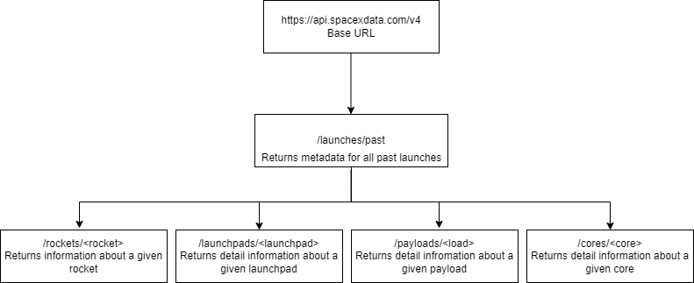
Data Collection – SpaceX API
SpaceX makes their launch data publicly available via REST at https://api.spacexdata.com/v4
Notebook: https://github.com/J-William/SpaceY-Data-Science/blob/master/Data-Collection-API.ipynb

Slide 9
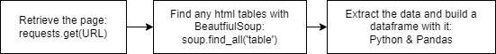
Data Collection - Scraping
This Wikipedia page that contains SpaceX launch data was also scraped to contribute data to the project: https://en.wikipedia.org/w/index.php?title=List_of_Falcon_9_and_Falcon_Heavy_launches&oldid=1027686922
Notebook: https://github.com/J-William/SpaceY-Data-Science/blob/master/Data-Collection-WebScraping.ipynb

Slide 10
Data Wrangling
Data was filtered to exclude any Falcon 1 launches leaving only Falcon 9 launches.
Missing payload mass values were interpolated with the mean payload mass.
Landing outcomes were converted from complex evaluations to a categorical success/failure feature.
Notebook: https://github.com/J-William/SpaceY-Data-Science/blob/master/Data-Wrangling.ipynb

Slide 11
EDA with Data Visualization
Flight Number, Launch Site, and outcome were compared with a scatter plot to investigate potential relationships between number of flights and success rate.
Payload Mass, Launch Site, and outcome were compared with a scatter plot to investigate potential relationships between Payload Mass and success rate.
Orbit Types and outcome were plotted on a bar chart to investigate potential relationships between Orbit Type and success rate.
Flight Number and Orbit Type were plotted as a scatter plot to investigate potential relationships between number of flights, orbit types and success rate.
Payload Mass and Orbit Type were plotted as a scatter plot to investigate potential relationships between Payload Mass, Orbit Type, and success rate.
Outcomes over time were plotted to investigate potential relationships between time and success rate.
Notebook: https://github.com/J-William/SpaceY-Data-Science/blob/master/EDA-Visualization.ipynb

Slide 12
EDA with SQL
Launch sites were examined:
SELECT DISTINCT launch_site FROM SPACEXTBL;
SELECT * FROM SPACEXTBL WHERE launch_site like ‘CCA’;
Payload Mass for NASA was examined:
SELECT sum(payload_mass__kg_) FROM SPACEXTBL WHERE customer= ‘NASA (CRS)’;
Average Payload Mass carried by booster version F9v1.1 was examined:
SELECT avg(payload_mass__kg_) FROM SPACEXTBL WHERE booster_version LIKE ‘F9 v1.1%’;
First success date was examined:
SELECT min(date) FROM SPACEXTBL WHERE landing_outcome = ‘Success (groud pad)’;
Boosters which have success in drone ship and have payload mass greater than 4000 but less than 6000 was examined:
SELECT DISTINCT booster_version FROM SPACEXTBL WHERE landing__outcome= ‘Success (drone ship)’ AND payload_mass__kg_ BETWEEN 4000 AND 6000;
Total number of success/failures was examined:
SELECT mission_outcome, count(mission_outcome) FROM SPACEXTBL GROUP BY mission_outcome;
Booster versions which have carried the maximum payload mass were examined:
SELECT DISTINCT booster_version FROM SPACEXTBL WHERE payload_mass__kg_ = (SELECT MAX(payload_mass_kg_) FROM SPACEXTBL);
Failed landing outcomes were examined:
SELECT landing__outcome, booster_version, launch_site, date FROM SPACEXTBL WHERE extract(YEAR FROM date) = 2015 AND landing__outcome = ‘Failure (drone ship)’;
Landing outcomes between specific dates were examined:
SELECT landing__outcome, count(landing_outcome) FROM SPACEXTBL WHERE date BETWEEN DATE(‘2010-06-04’) AND DATE(‘2017-03-20’) GROUP BY landing__outcome ORDER BY 2 DESC;
Notebook: https://github.com/J-William/SpaceY-Data-Science/blob/master/EDA-SQL.ipynb

Slide 13
Build an Interactive Map with Folium
Summarize what map objects such as markers, circles, lines, etc. you created and added to a folium map
Explain why you added those objects
Add the GitHub URL of your completed interactive map with Folium map, as an external reference and peer-review purpose

Slide 14
Build a Dashboard with Plotly Dash
Summarize what plots/graphs and interactions you have added to a dashboard
Explain why you added those plots and interactions
Add the GitHub URL of your completed Plotly Dash lab, as an external reference and peer-review purpose

Slide 15
Predictive Analysis (Classification)
Summarize how you built, evaluated, improved, and found the best performing classification model
You need present your model development process using key phrases and flowchart
Add the GitHub URL of your completed predictive analysis lab, as an external reference and peer-review purpose

Slide 16
Results
Exploratory data analysis results
Interactive analytics demo in screenshots
Predictive analysis results

Slide 17

Section 2

Slide 18
Flight Number vs. Launch Site
Show a scatter plot of Flight Number vs. Launch Site
Show the screenshot of the scatter plot with explanations

Slide 19
Payload vs. Launch Site
Show a scatter plot of Payload vs. Launch Site
Show the screenshot of the scatter plot with explanations

Slide 20
Success Rate vs. Orbit Type
Show a bar chart for the success rate of each orbit type
Show the screenshot of the scatter plot with explanations

Slide 21
Flight Number vs. Orbit Type
Show a scatter point of Flight number vs. Orbit type
Show the screenshot of the scatter plot with explanations

Slide 22
Payload vs. Orbit Type
Show a scatter point of payload vs. orbit type
Show the screenshot of the scatter plot with explanations

Slide 23
Launch Success Yearly Trend
Show a line chart of yearly average success rate
Show the screenshot of the scatter plot with explanations

Slide 24
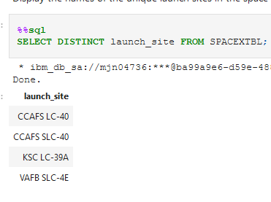
All Launch Site Names
Querying the names of all launch sites included in the data set.

Slide 25
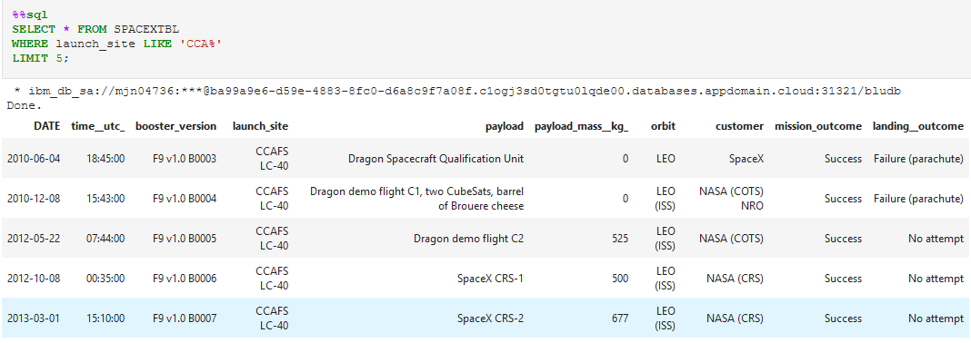
Launch Site Names Begin with 'CCA'
Querying a few records with launch site names that begin with the string ‘CCA’.

Slide 26
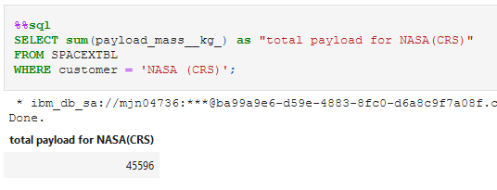
Total Payload Mass
Calculating the total payload mass carried by boosters launched for NASA (CRS).

Slide 27
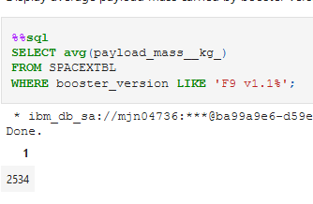
Average Payload Mass by F9 v1.1
Calculating the average payload mass carried by booster version F9 v1.1.

Slide 28
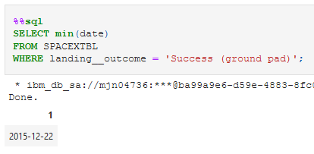
First Successful Ground Landing Date
Finding the date of the first successful landing on a ground pad.

Slide 29
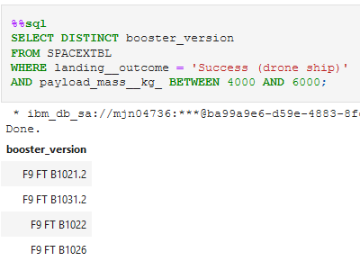
Successful Drone Ship Landing with Payload between 4000 and 6000
Finding the names of all boosters which have successfully landed on a drone ship with payload mass between 4000 and 6000.

Slide 30
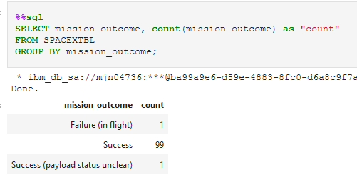
Total Number of Successful and Failure Mission Outcomes
Analyzing the count of different mission outcomes. (not landing outcomes)

Slide 31
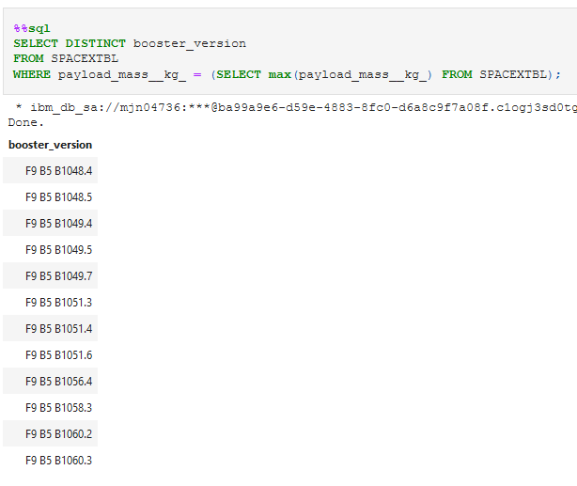
Boosters Carried Maximum Payload
Finding the booster versions that have carried the maximum payload mass.

Slide 32
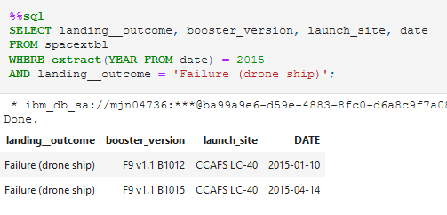
2015 Launch Records
Listing the failed landing outcomes in drone ship, their booster versions, and launch site names for year 2015

Slide 33
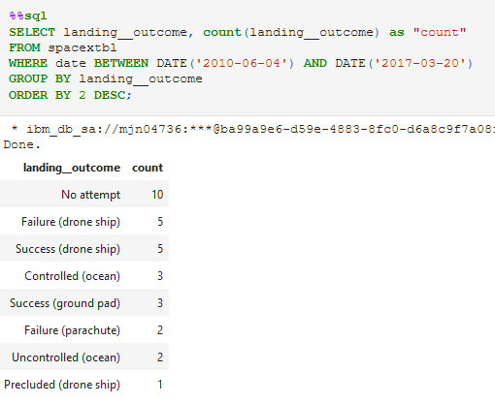
Rank Landing Outcomes Between 2010-06-04 and 2017-03-20
Ranking the count of landing outcomes between 2010-06-04 and 2017-03-20 in descending order.

Slide 34

Section 3

Slide 35
<Folium Map Screenshot 1>
Replace <Folium map screenshot 1> title with an appropriate title
Explore the generated folium map and make a proper screenshot to include all launch sites’ location markers on a global map
Explain the important elements and findings on the screenshot

Slide 36
<Folium Map Screenshot 2>
Replace <Folium map screenshot 2> title with an appropriate title
Explore the folium map and make a proper screenshot to show the color-labeled launch outcomes on the map
Explain the important elements and findings on the screenshot

Slide 37
<Folium Map Screenshot 3>
Replace <Folium map screenshot 3> title with an appropriate title
Explore the generated folium map and show the screenshot of a selected launch site to its proximities such as railway, highway, coastline, with distance calculated and displayed
Explain the important elements and findings on the screenshot

Slide 38

Section 4

Slide 39
<Dashboard Screenshot 1>
Replace <Dashboard screenshot 1> title with an appropriate title
Show the screenshot of launch success count for all sites, in a piechart
Explain the important elements and findings on the screenshot

Slide 40
<Dashboard Screenshot 2>
Replace <Dashboard screenshot 2> title with an appropriate title
Show the screenshot of the piechart for the launch site with highest launch success ratio
Explain the important elements and findings on the screenshot

Slide 41
<Dashboard Screenshot 3>
Replace <Dashboard screenshot 3> title with an appropriate title
Show screenshots of Payload vs. Launch Outcome scatter plot for all sites, with different payload selected in the range slider
Explain the important elements and findings on the screenshot, such as which payload range or booster version have the largest success rate, etc.

Slide 42

Section 5

Slide 43
Classification Accuracy
All of the models perform with practically the same accuracy.

Slide 44
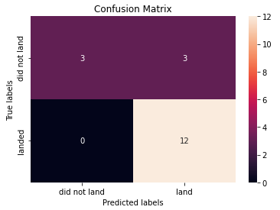
Confusion Matrix
The models performed with practically similar results including their confusion matrices. Here we see all of the error is in false positives; where the model erroneously predicted successful landings.

Slide 45
Conclusions
All of the predictive models performed practically identically.
This is likely due to the size of the dataset; a larger sample size of data would be much more desirable.
All of the error was in false positives i.e. erroneous predictions of success.
Though the lack of variation in performance between models is worrisome the overall prediction accuracy of ~84% seems promising.
Based on the outcome a well-tuned model built on a much larger dataset would likely provide enough utility to justify it’s cost.

Slide 46
Appendix
Project repository:
https://github.com/J-William/SpaceY-Data-Science/

Slide 47


